Slide 1
Reconfigurable Computing & Its Use in Space Applications in 10 minutes…
Dr. Brock J. LaMeres
Associate Professor
Department of Electrical & Computer Engineering

Slide 2
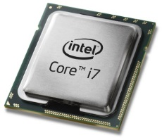
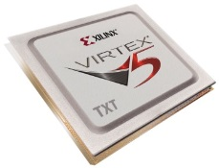
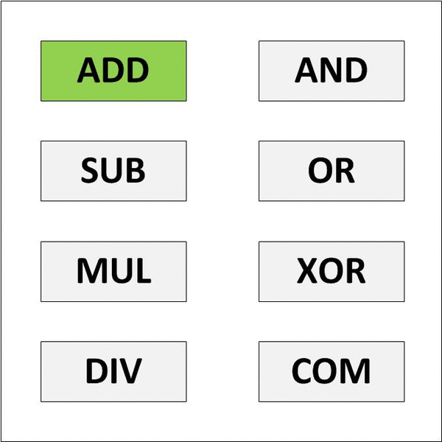
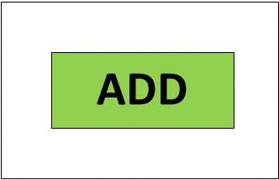
What is Reconfigurable Computing
A System That Alters Its Hardware as its Normal Operating Procedure
This can be done in real-time or at compile time.
This can be done on the full-chip, or just on certain portions.
Changing the hardware allows it to be optimized for the application at hand.
Today’s Computers are Based on a General-Purpose Processor
The GP CPU is designed to do many things.
This is the “Jack of All Trades, Master of None” approach.
General Purpose CPU Model
Reconfigurable Computing Model

Slide 3
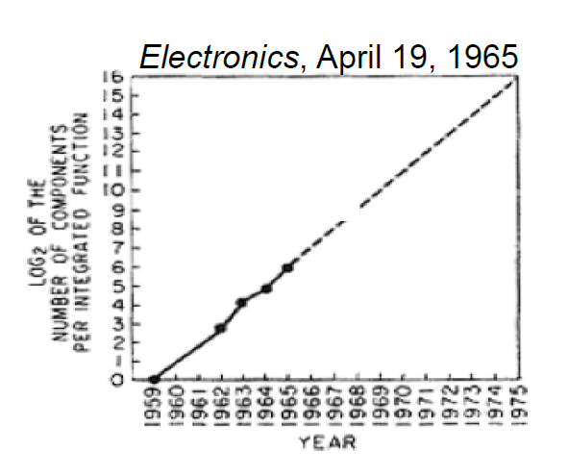
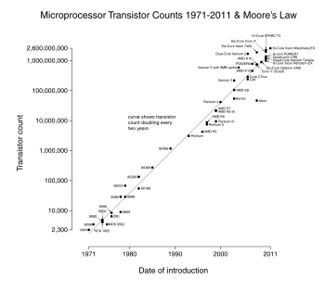
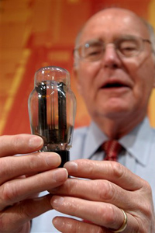
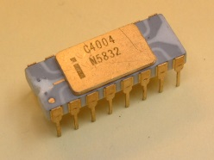
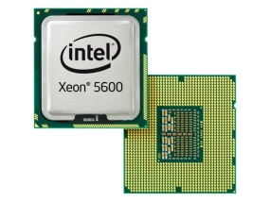
Who Cares?
Our Existing Computers Seem to be Working Well. Why Change?
Our existing computers have benefited from 40 years of Moore’s Law.
In the 1960’s, Gordon Moore predicted that the number of transistors on a chip would double every ~24 months.
1959 - 1965
1971* - 2011
Gordon Moore, co-founder of Intel, holding a vacuum tube.
Intel 4004 (2300 T)
Intel Xeon (2B T)
Note: First microprocessor introduced in 1971,
the Intel 4004 with 2300 transistors.

Slide 4
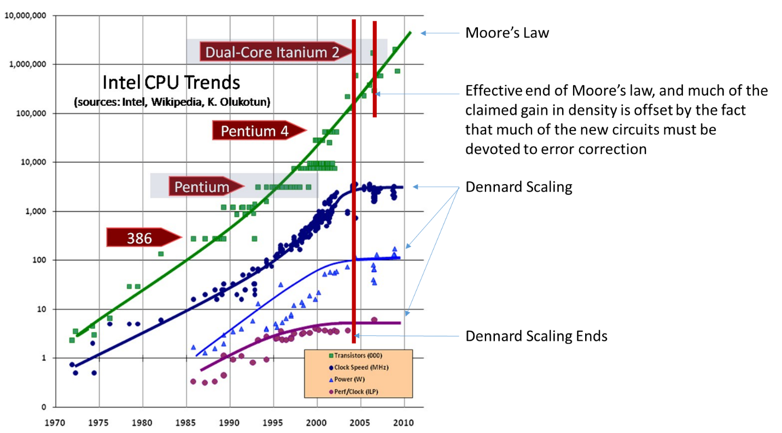
How long can we do this?
When will Moore’s Law End?
Most exponentials do come to an end.
Clock Speed
Power
Performance per Clock Cycle
But is transistor count what we care about?

Slide 5
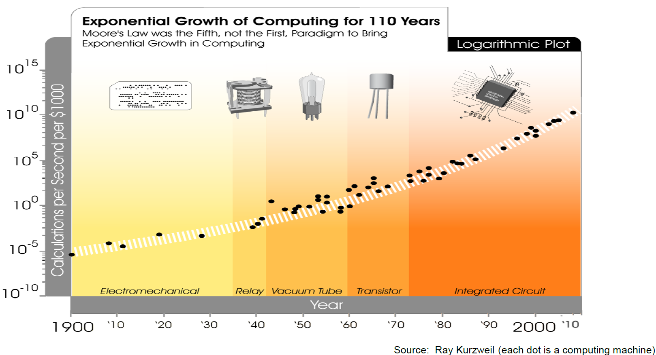
Computation vs. Transistor Count
We Really Care About Computation
You Are Here

Slide 6
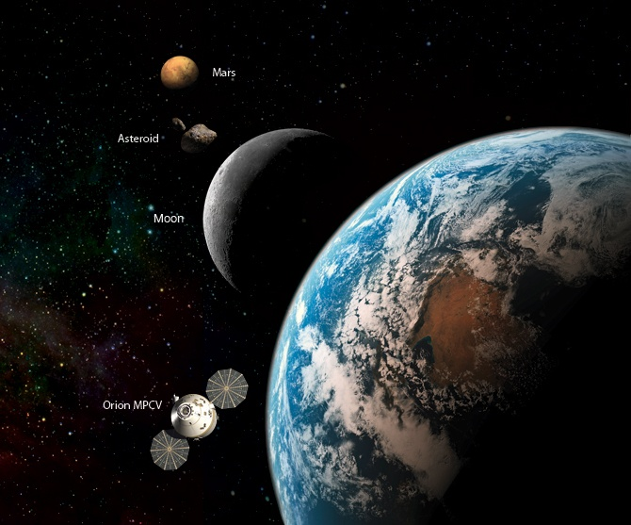
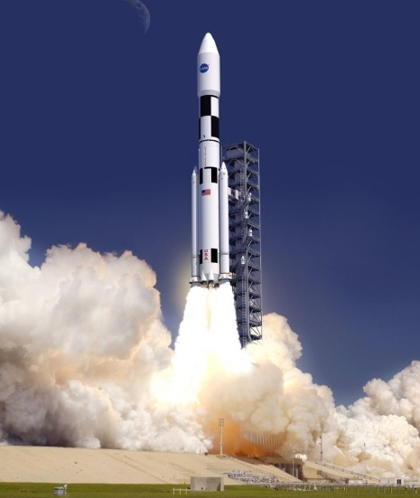
The Promise of RC
A Computer Always Needs an Application
We discovered that space computers could be greatly enhanced by RC.
They need to be light. RC reuses hardware, that saves mass.

Slide 7
The Promise of RC
A Computer Always Needs an Application
We discovered that space computers could be greatly enhanced by RC.
They need to be light. RC reuses hardware, that saves mass.
They need to be low power. RC eliminates unnecessary circuitry.

Slide 8
The Promise of RC
A Computer Always Needs an Application
We discovered that space computers could be greatly enhanced by RC.
They need to be light. RC reuses hardware, that saves mass.
They need to be low power. RC eliminates unnecessary circuitry.
They need to have high computation. RC can do that.

Slide 9
The Promise of RC
A Computer Always Needs an Application
We discovered that space computers could be greatly enhanced by RC.
They need to be light. RC reuses hardware, that saves mass.
They need to be low power. RC eliminates unnecessary circuitry.
They need to have high computation. RC can do that.
They need to operate in the presence of harsh radiation.
Can you repeat the question???

Slide 10
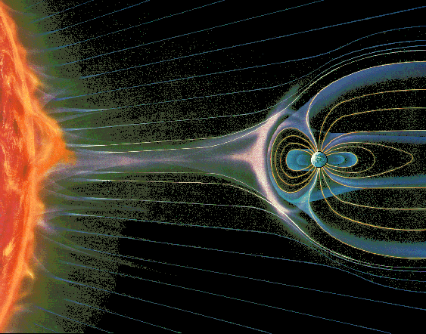
Where Does Radiation Come From?
1) Cosmic Rays
2) Solar Particle Events
3) Trapped Radiation

Slide 11
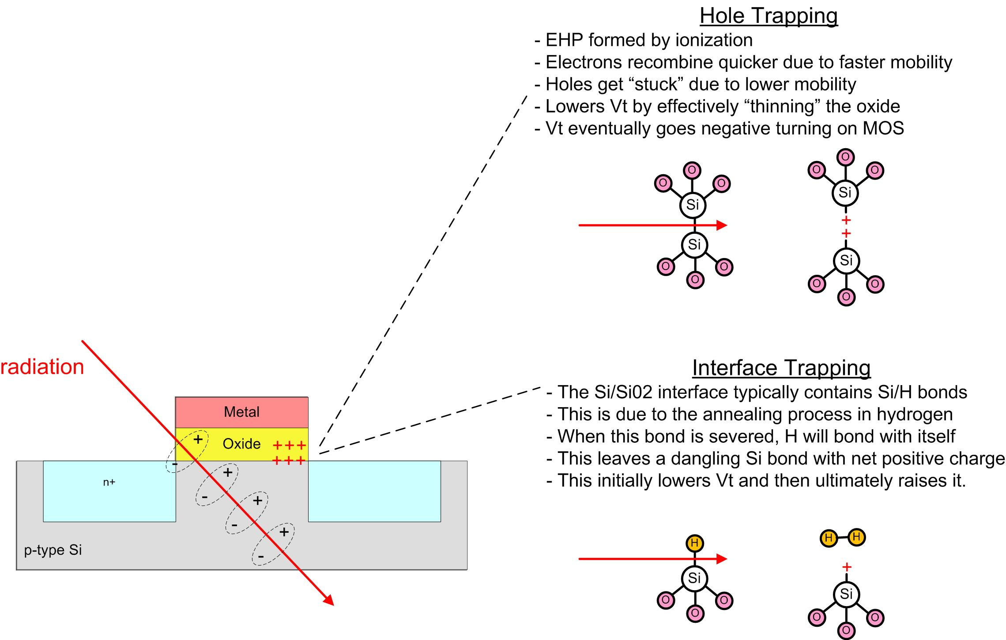
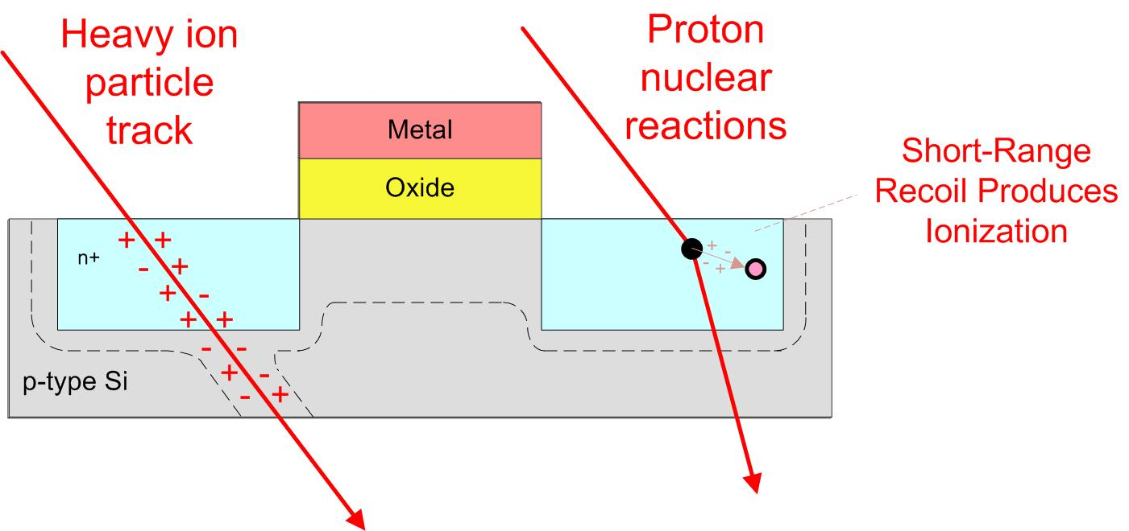
What are the Effects?
1. Total Ionizing Dose (TID)
Cumulative long term damage due to ionization.
Primarily due to low energy protons and electrons due to higher, more constant flux, particularly when trapped
Problem #1 – Oxide Breakdown
Threshold Shifts
Leakage Current
Timing Changes
2. Single Event Effects (SEE)
Electron/hole pairs created by a single particle passing through semiconductor
Primarily due to heavy ions and high energy protons
Excess charge carriers cause current pulses
Creates a variety of destructive and non-destructive damage “Critical Charge” = the amount of charge deposited to change the state of a gate

Slide 12
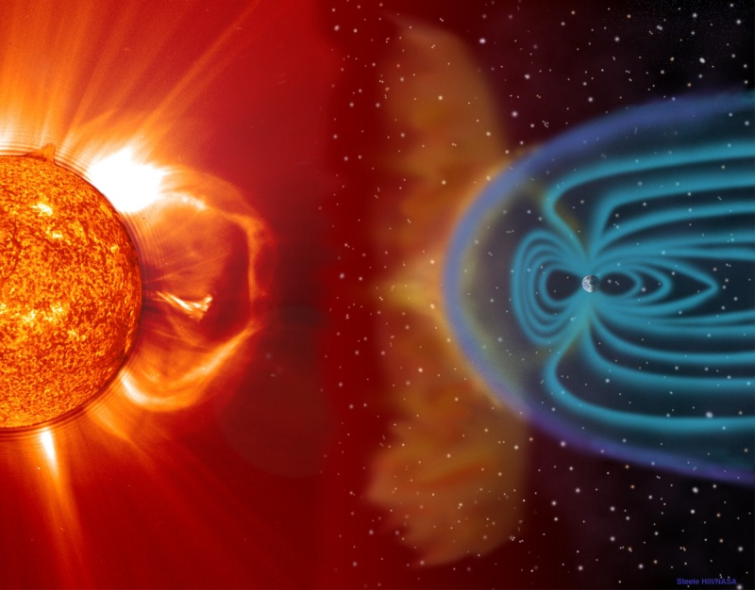
But I’m Texting Right Now?
How can our computers function?
You Are Here
Thank you atmosphere. Thank you magnetosphere

Slide 13
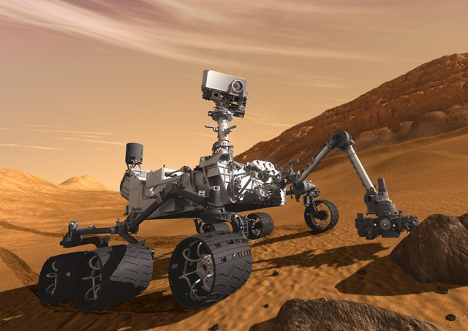
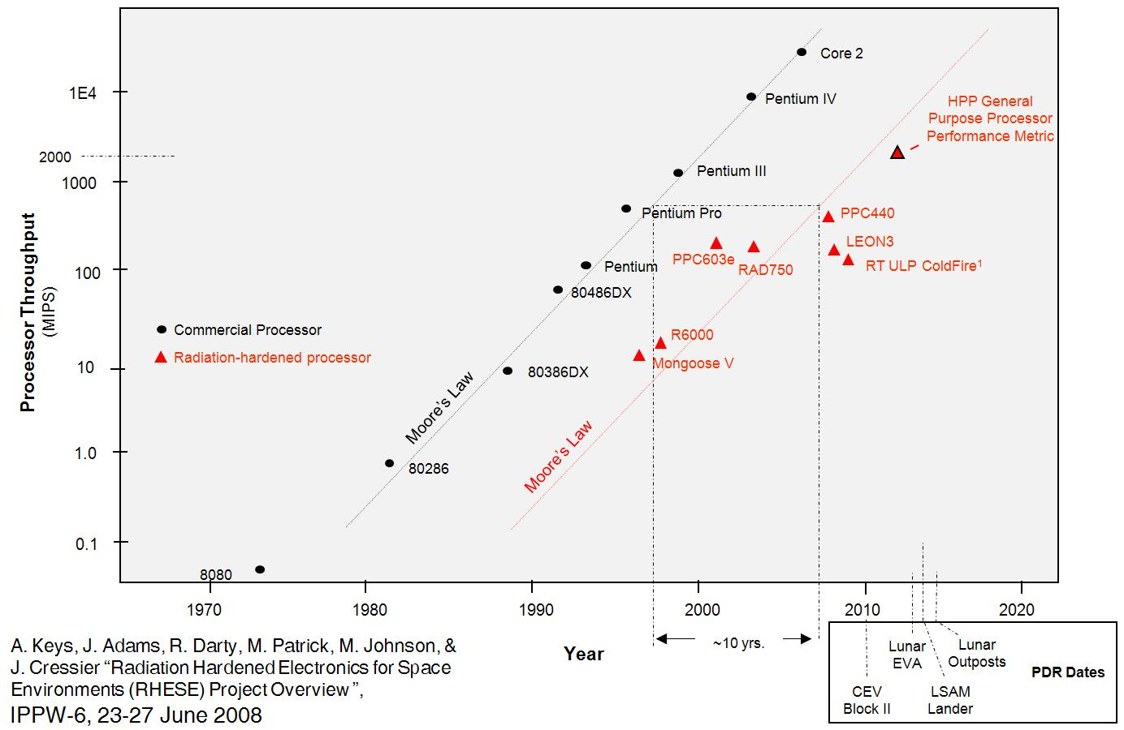
But there are computers in space?
Stuff is in space now, how does it function?
Rad-Hard Processors Can be Made that are SLOW and EXPENSIVE
Rad-Hard computers tend to lag commercial versions in performance by 10+ years.
They are also 100s-1000x more expensive.
A-Side Computer
BAE Rad750 $200,000
B-Side Computer
BAE Rad750 $200,000
Thank you federal government.

Slide 14
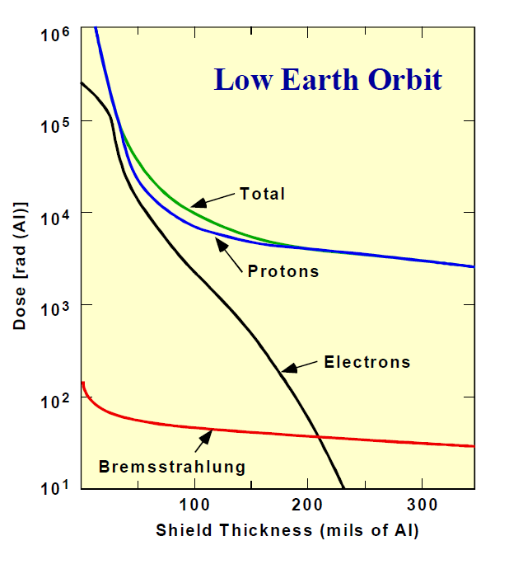
I Know You’re Going to Ask….
Can’t you just add shielding?
Shielding helps for protons and electrons <30MeV, but has diminishing returns after 0.25”.
This shielding is typically inherent in the satellite/spacecraft design, meaning the most optimal amount of shielding is usually present in the shell of the spacecraft.
Shield Thickness vs. Dose Rate (LEO)

Slide 15
How Does RC Help This?
Total Ionizing Dose
TID actually diminishes as features get smaller.
This is good because we want to use the smallest transistors to get the fastest performance.
Using off-the-shelf parts also reduces cost.
Single Event Effects
SEE gets worse! But it isn’t permanent.
So we just need a new computer architecture to handle it.

Slide 16
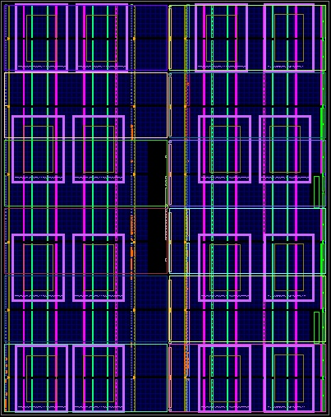
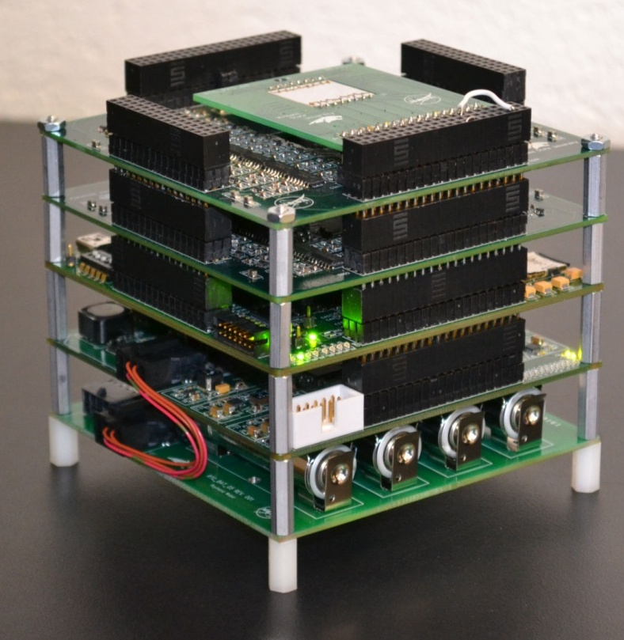
Enter MSU
FPGA-Based, Radiation Tolerant Computer
The FPGA is divided up into Tiles
A Tile is a quantum of resources that:
Fully contains a system (e.g., processor, accelerator)
Can be programmed via partial reconfiguration (PR)
Fault Tolerance
TMR + Spares
Spatial Avoidance of Background Repair
Scrubbing
An External Radiation Sensor
16 Tile System on an Xilinx Virtex-6

Slide 17
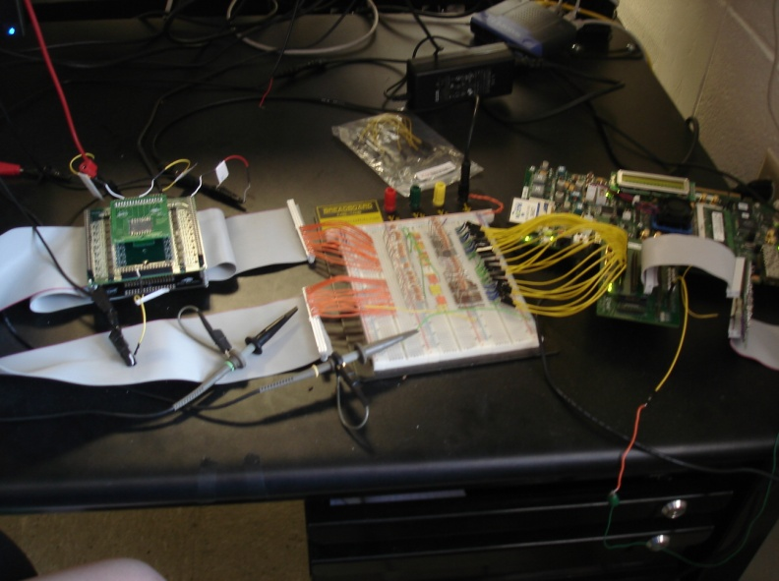
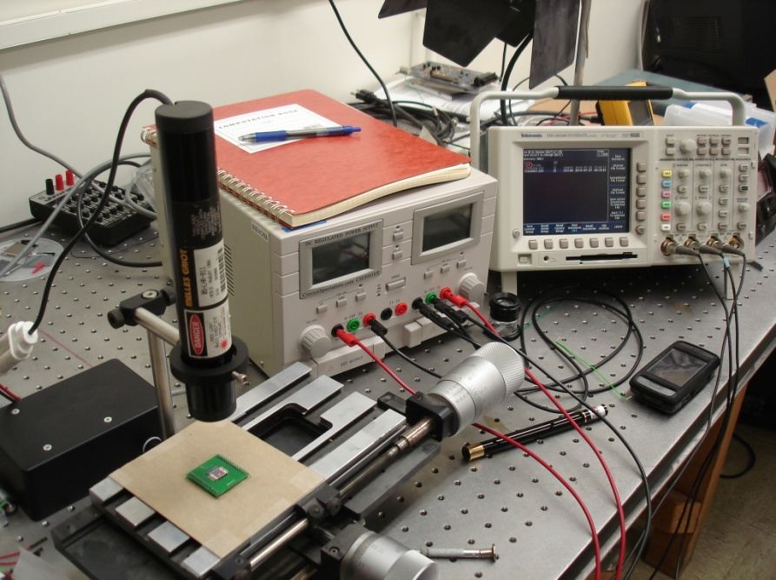
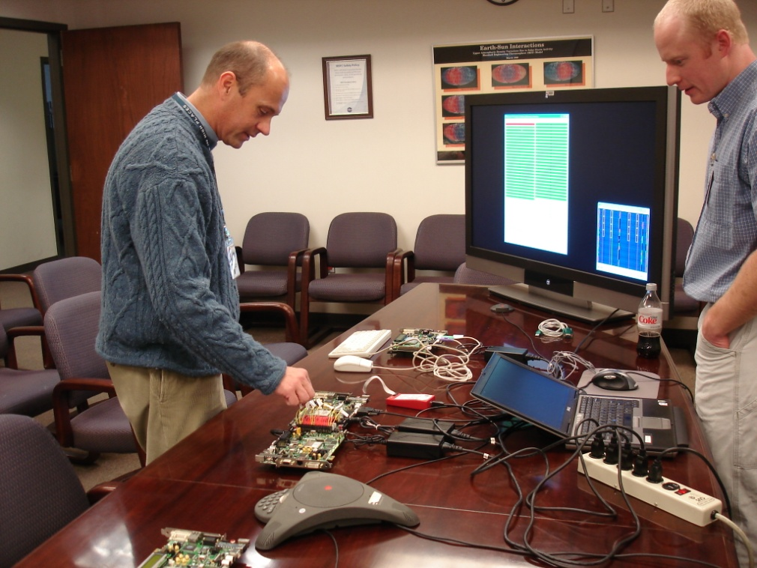
Technical Readiness Level (TRL-1)
Step 1 – Understand the Problem and See if RC Helps
The Montana Space Grant Consortium funds an investigation into conducting radiation tolerant computing research at MSU. The goal is to understand the problem, propose a solution, and build relationships with scientists at NASA.
Clint Gauer (MSEE from MSU 2009) demo’s computer to MSFC Chief of Technology Andrew Keys
Timeline of Activity at MSU
Proof of Concept
(2008-2010)
2008
2009
2010
2011
2012
2013
2014
2015
2016

Slide 18
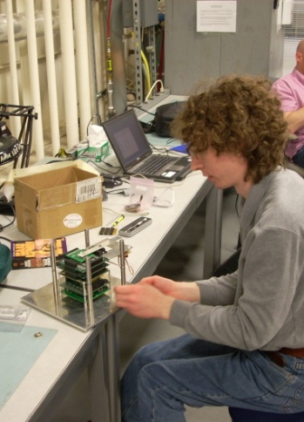
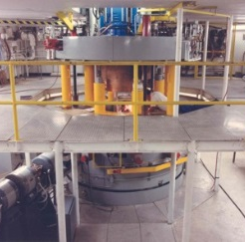
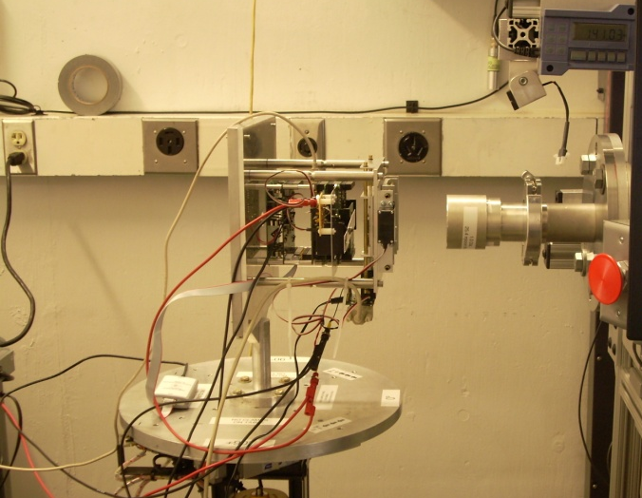
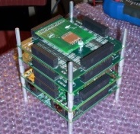
Technical Readiness Level (TRL-3)
Step 2 – Build a Prototype and Test in a Cyclotron
NASA funds the development of a more functional prototype and testing under bombardment by radiation at the Texas A&M Radiation Effects Facility.
Ray Weber (Ph.D., EE from MSU, 2014) prepares experiment.
Timeline of Activity at MSU
Proof of Concept
Prototype Development & Cyclotron Testing
(2008-2010)
(2010-2012)
2008
2009
2010
2011
2012
2013
2014
2015
2016

Slide 19
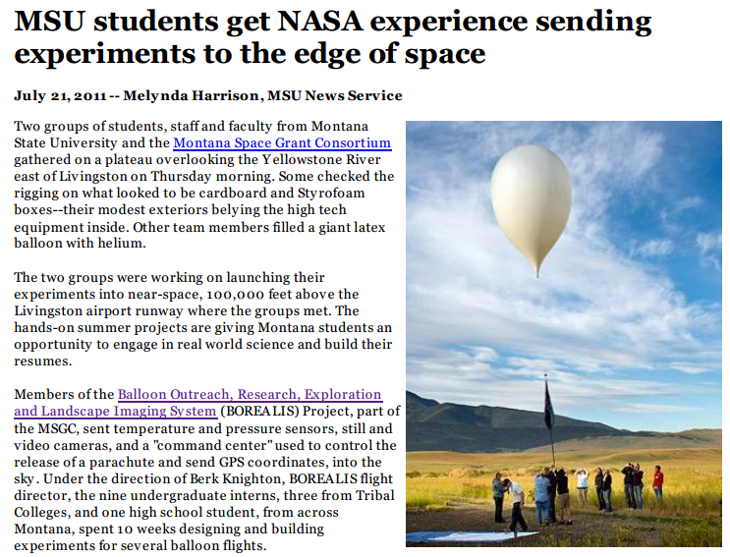
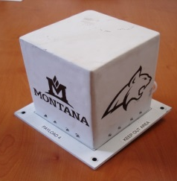
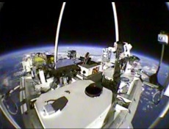
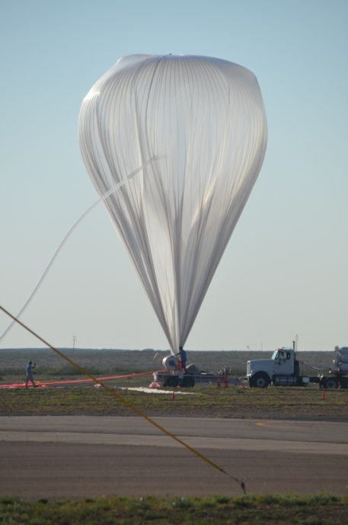
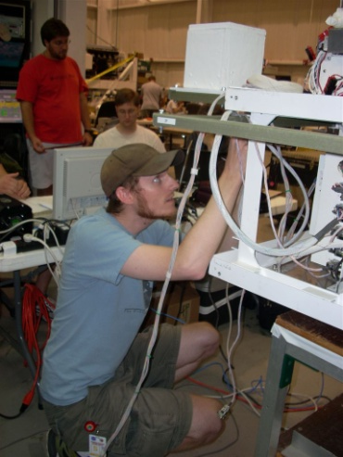
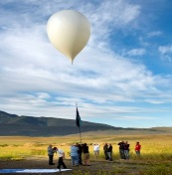
Technical Readiness Level (TRL-5)
Step 3 – Demonstrate as Flight Hardware on High Altitude Balloons
NASA funds the development of the computer into flight hardware for demonstration on high altitude balloon systems, both in Montana and at NASA.
MSU Computer
Timeline of Activity at MSU
Justin Hogan (Ph.D., EE from MSU, 2014) prepares payload.
Proof of Concept
Prototype Development & Cyclotron Testing
High Altitude Balloon Demos
(2008-2010)
(2010-2012)
(2011-2013)
2008
2009
2010
2011
2012
2013
2014
2015
2016

Slide 20
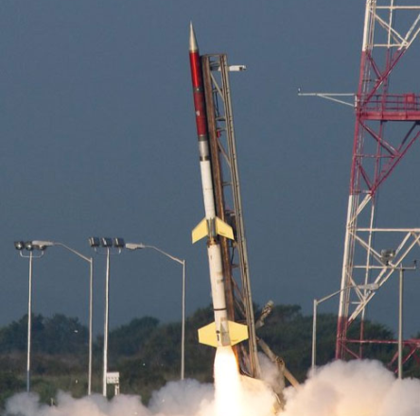
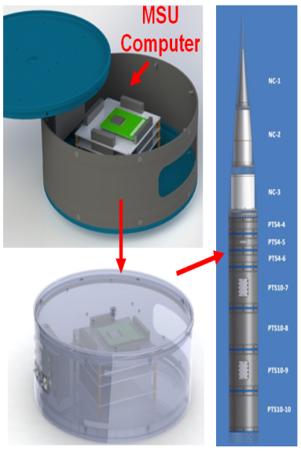
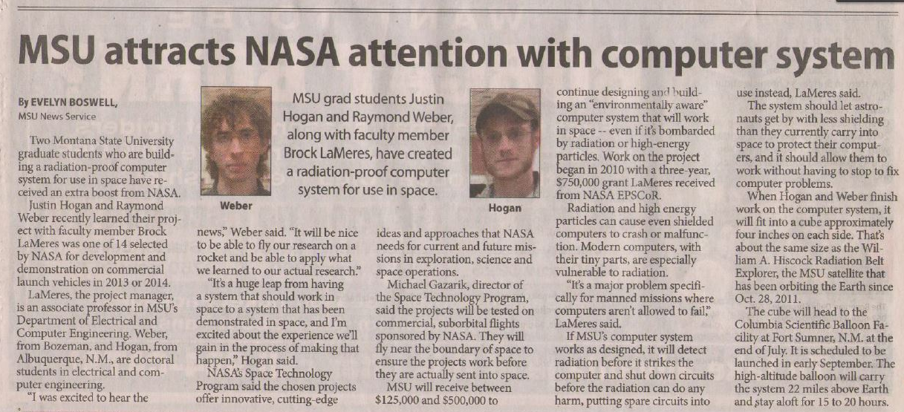
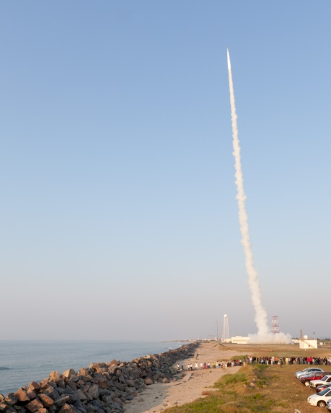
Technical Readiness Level (TRL-7)
Step 4 – Demonstrate as Flight Hardware on a Sounding Rocket
NASA funds the demonstration of the computer system on sounding rocket.
Payload is integrated and will fly on 10/20/14 at White Sands Missile Range.
Justin Hogan and
Ray Weber
(MSU Ph.D. Grads) at rocket training boot camp in 2012.
Timeline of Activity at MSU
Proof of Concept
Prototype Development & Cyclotron Testing
High Altitude Balloon Demos
Sounding Rocket Demo
(2008-2010)
(2010-2012)
(2011-2013)
(2012-2014)
2008
2009
2010
2011
2012
2013
2014
2015
2016

Slide 21
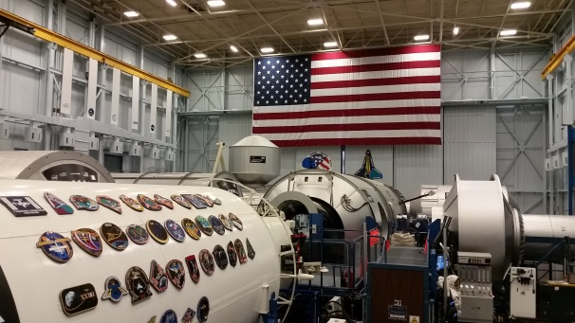
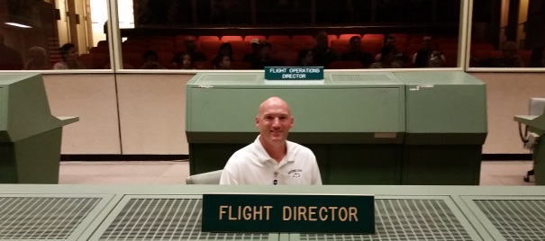
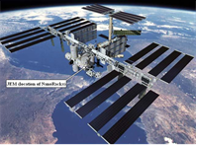
Technical Readiness Level (TRL-8)
Step 5 – Demonstrate on the International Space Station
NASA funds the demonstration of computer system in International Space Station.
ISS Mockup at Johnson Space Center for Crew Training
Mission Control Room for Apollo Program
Timeline of Activity at MSU
Proof of Concept
Prototype Development & Cyclotron Testing
High Altitude Balloon Demos
Sounding Rocket Demo
ISS
Demo
(2008-2010)
(2010-2012)
(2011-2013)
(2012-2014)
(2014-2015)
2008
2009
2010
2011
2012
2013
2014
2015
2016

Slide 22
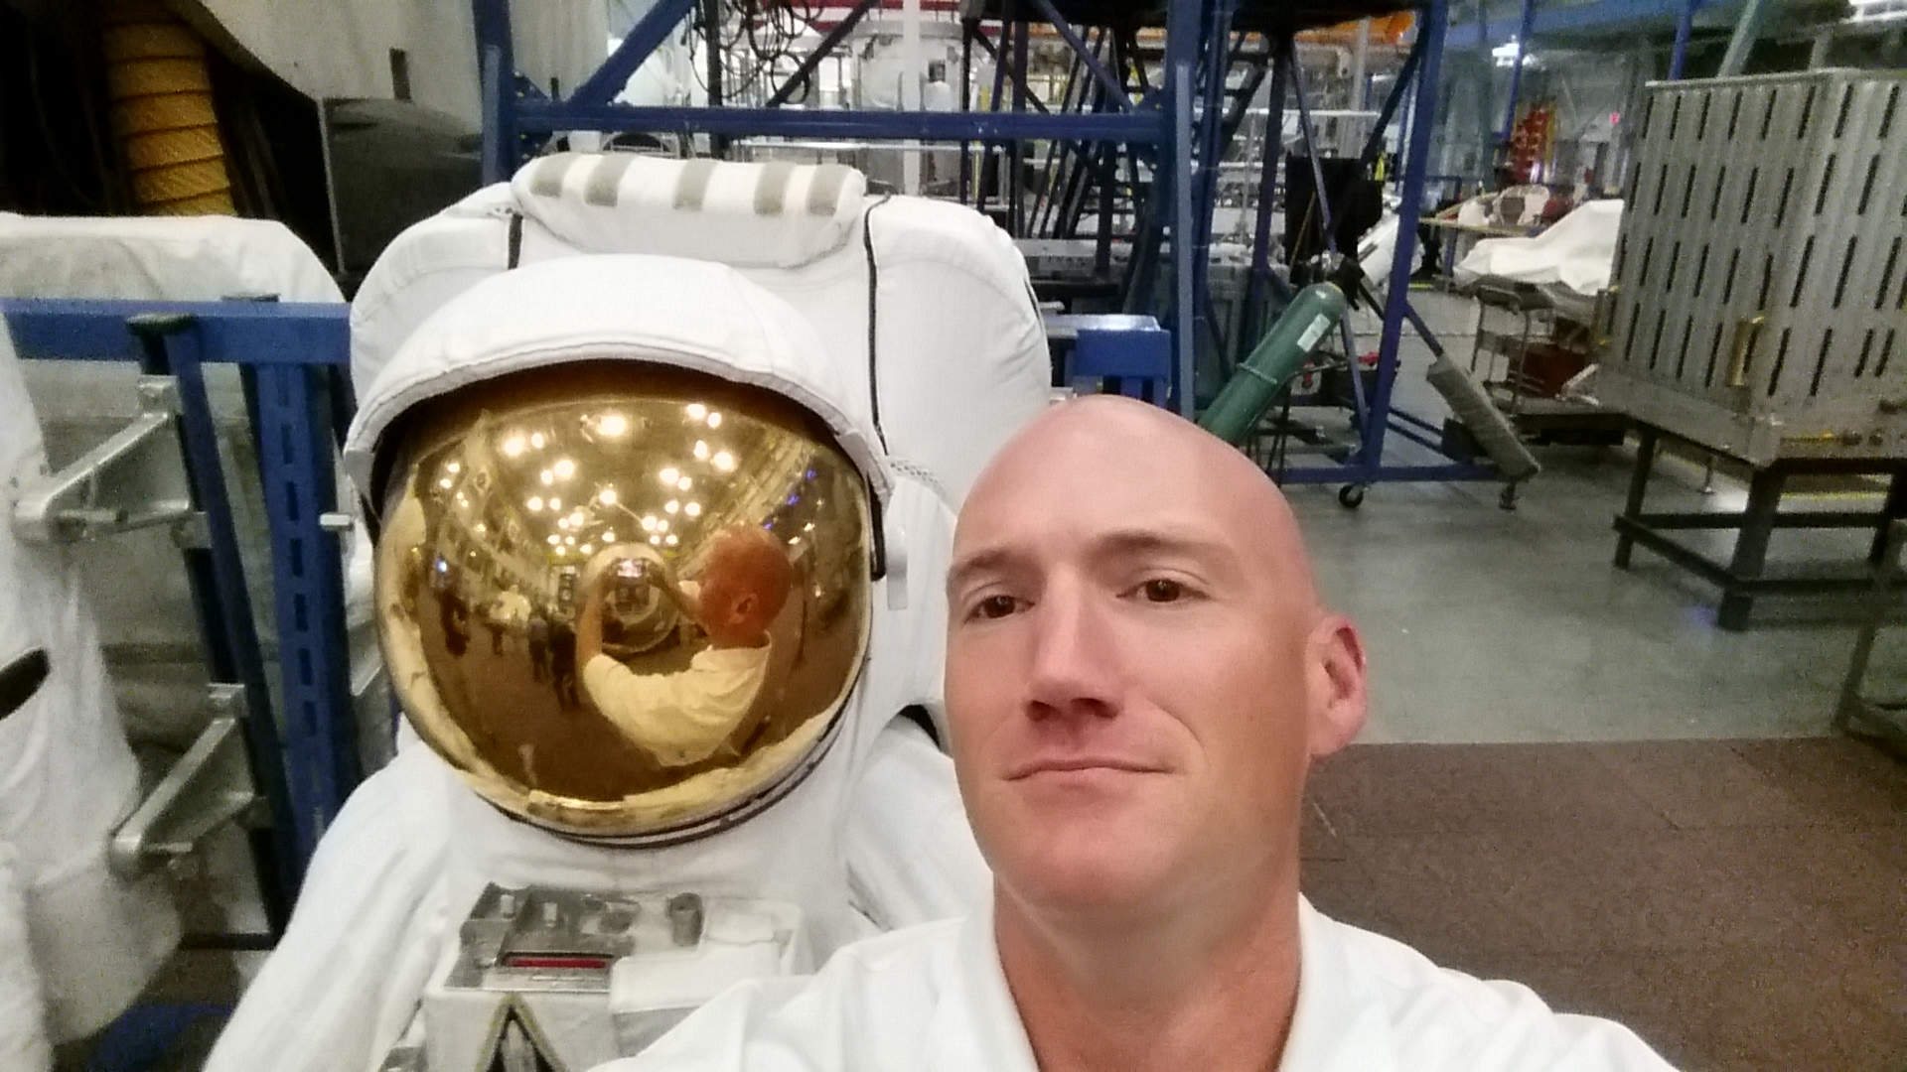
Technical Readiness Level (TRL-8)
Selfie with $60M Space Suit

Slide 23
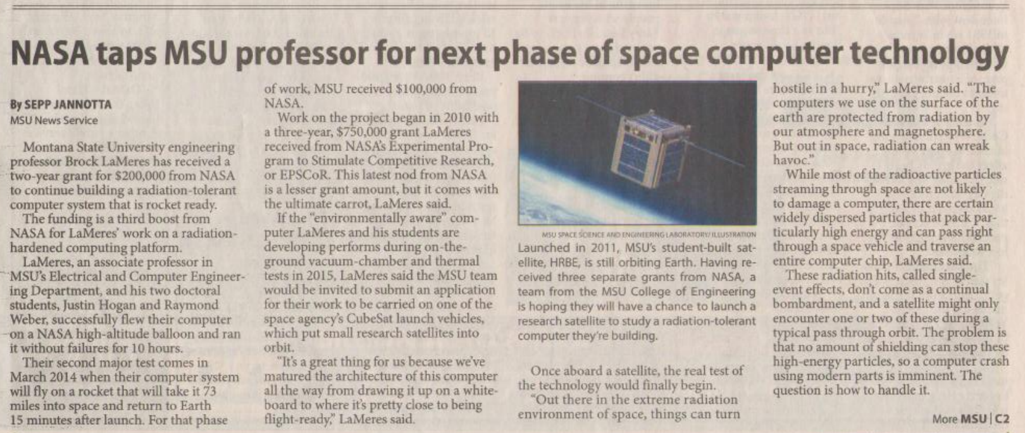
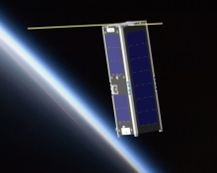
Technical Readiness Level (TRL-9)
Step 6 – Demonstrate as a Stand-Alone Satellite
NASA funds the demonstration of the computer system in a Low Earth Orbit mission.
Timeline of Activity at MSU
Proof of Concept
Prototype Development & Cyclotron Testing
High Altitude Balloon Demos
Sounding Rocket Demo
ISS
Demo
Satellite
Demo
(2008-2010)
(2010-2012)
(2011-2013)
(2012-2014)
(2014-2015)
(2014-2016)
2008
2009
2010
2011
2012
2013
2014
2015
2016

Slide 24
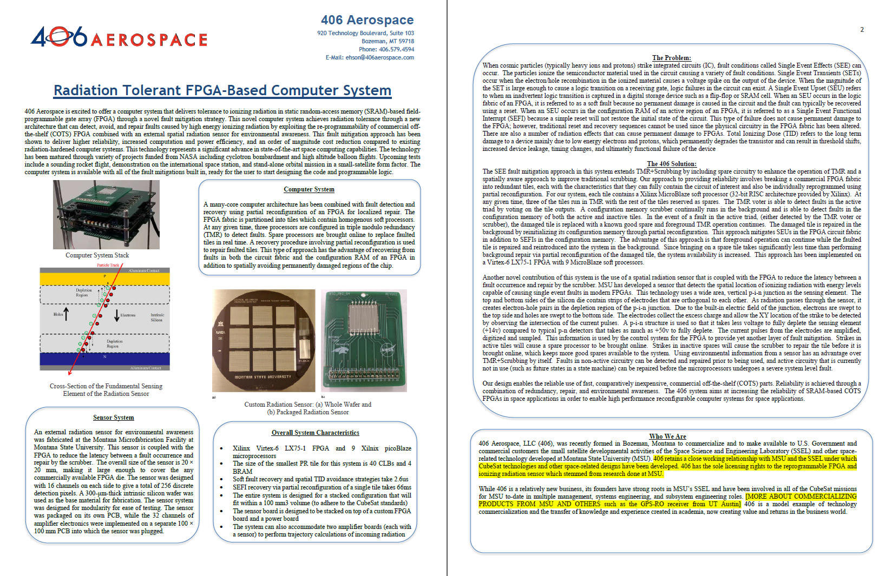
Technical Readiness Level (TRL-9)
Step 7 – Commercialize It
License Agreement with 406 Aerospace, LLC, Bozeman, MT.

Slide 25
Collaborators
Faculty & Scientists
Todd Kaiser, MSU Electrical & Computer Engineering Department
Ross Snider, MSU Electrical & Computer Engineering Department
Hunter Lloyd, MSU Computer Science Department
Robb Larson, MSU Mechanical & Industrial Engineering Department
Angela Des Jardins, MSU Physics Department & MSGC
Randy Larimer, MSU Electrical Engineering Department & MSGC
Berk Knighton, MSU Chemistry Department & MSGC
David Klumpar, MSU Physics Department & SSEL
Larry Springer, MSU Physics Department & SSEL
Ehson Mosleh, MSU Physics Department & SSEL
Gary Crum, NASA Goddard Space Flight Center
Thomas Flatley, NASA Goddard Space Flight Center
Leroy Hardin, NASA Marshall Space Flight Center
Kosta Varnavas, NASA Marshall Space Flight Center
Andrew Keys, NASA Marshall Space Flight Center
Robert Ray, NASA Marshall Space Flight Center
Leigh Smith, NASA Marshall Space Flight Center
Eric Eberly, NASA Marshall Space Flight Center
Alan George, University of Florida & NSF Center for High Performance Reconfig Comp.

Slide 26
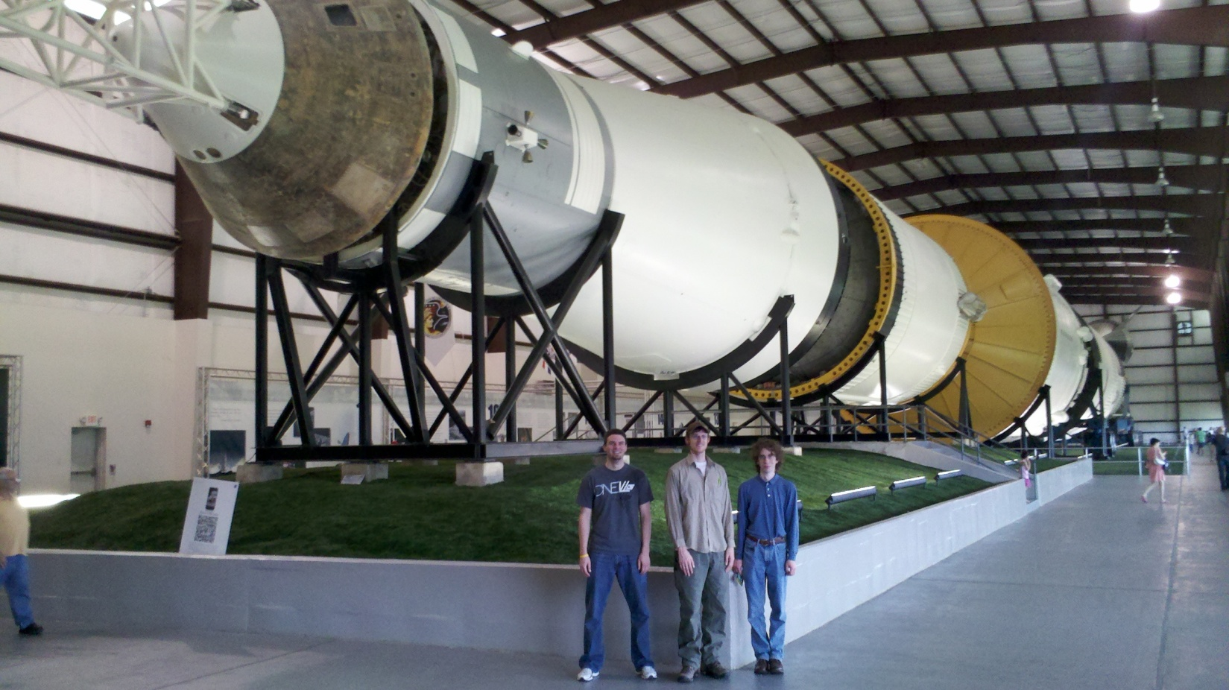
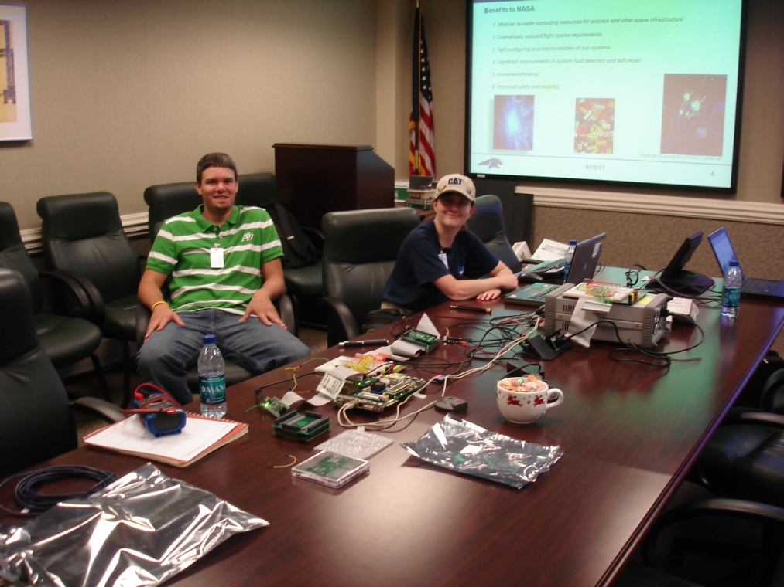
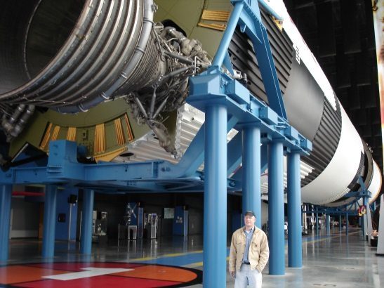
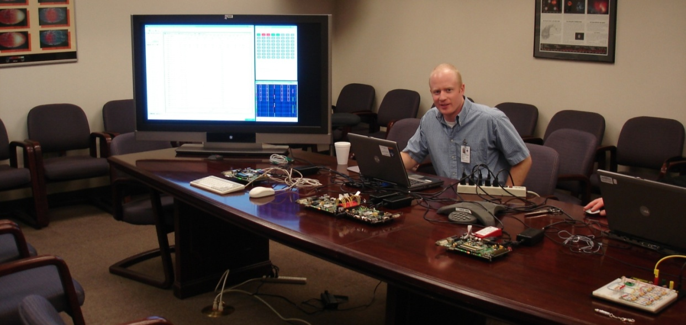
Students
Everything was Designed and Built By MSU Students!
Todd Buerkle, Justin Hogan, Ray Weber at Johnson Space Center for demo, 2012.
Todd Buerkle & Jennifer Hane demo computer at Marshall Space Flight Center, 2012.
Justin Hogan at the NASA Columbia Scientific Balloon Facility, 2012.
Clint Gauer at Marshall Space Flight Center for demo, 2009.
Clint Gauer demo’s computer at Marshall Space Flight Center, 2009.
Kaysha Young prepares payload for balloon flight, 2012.
2011 balloon team featured in MSU news story, 2011.
Todd Buerkle, Jennifer Hane at the Marshall Space Flight Center, 2011.
2013 balloon team recovers payload in front of moose, 2013.
Justin Hogan & Ray Weber featured in MSU News Story, 2012.

Slide 27
Thank You For Not
Asking Questions

